Slide 1

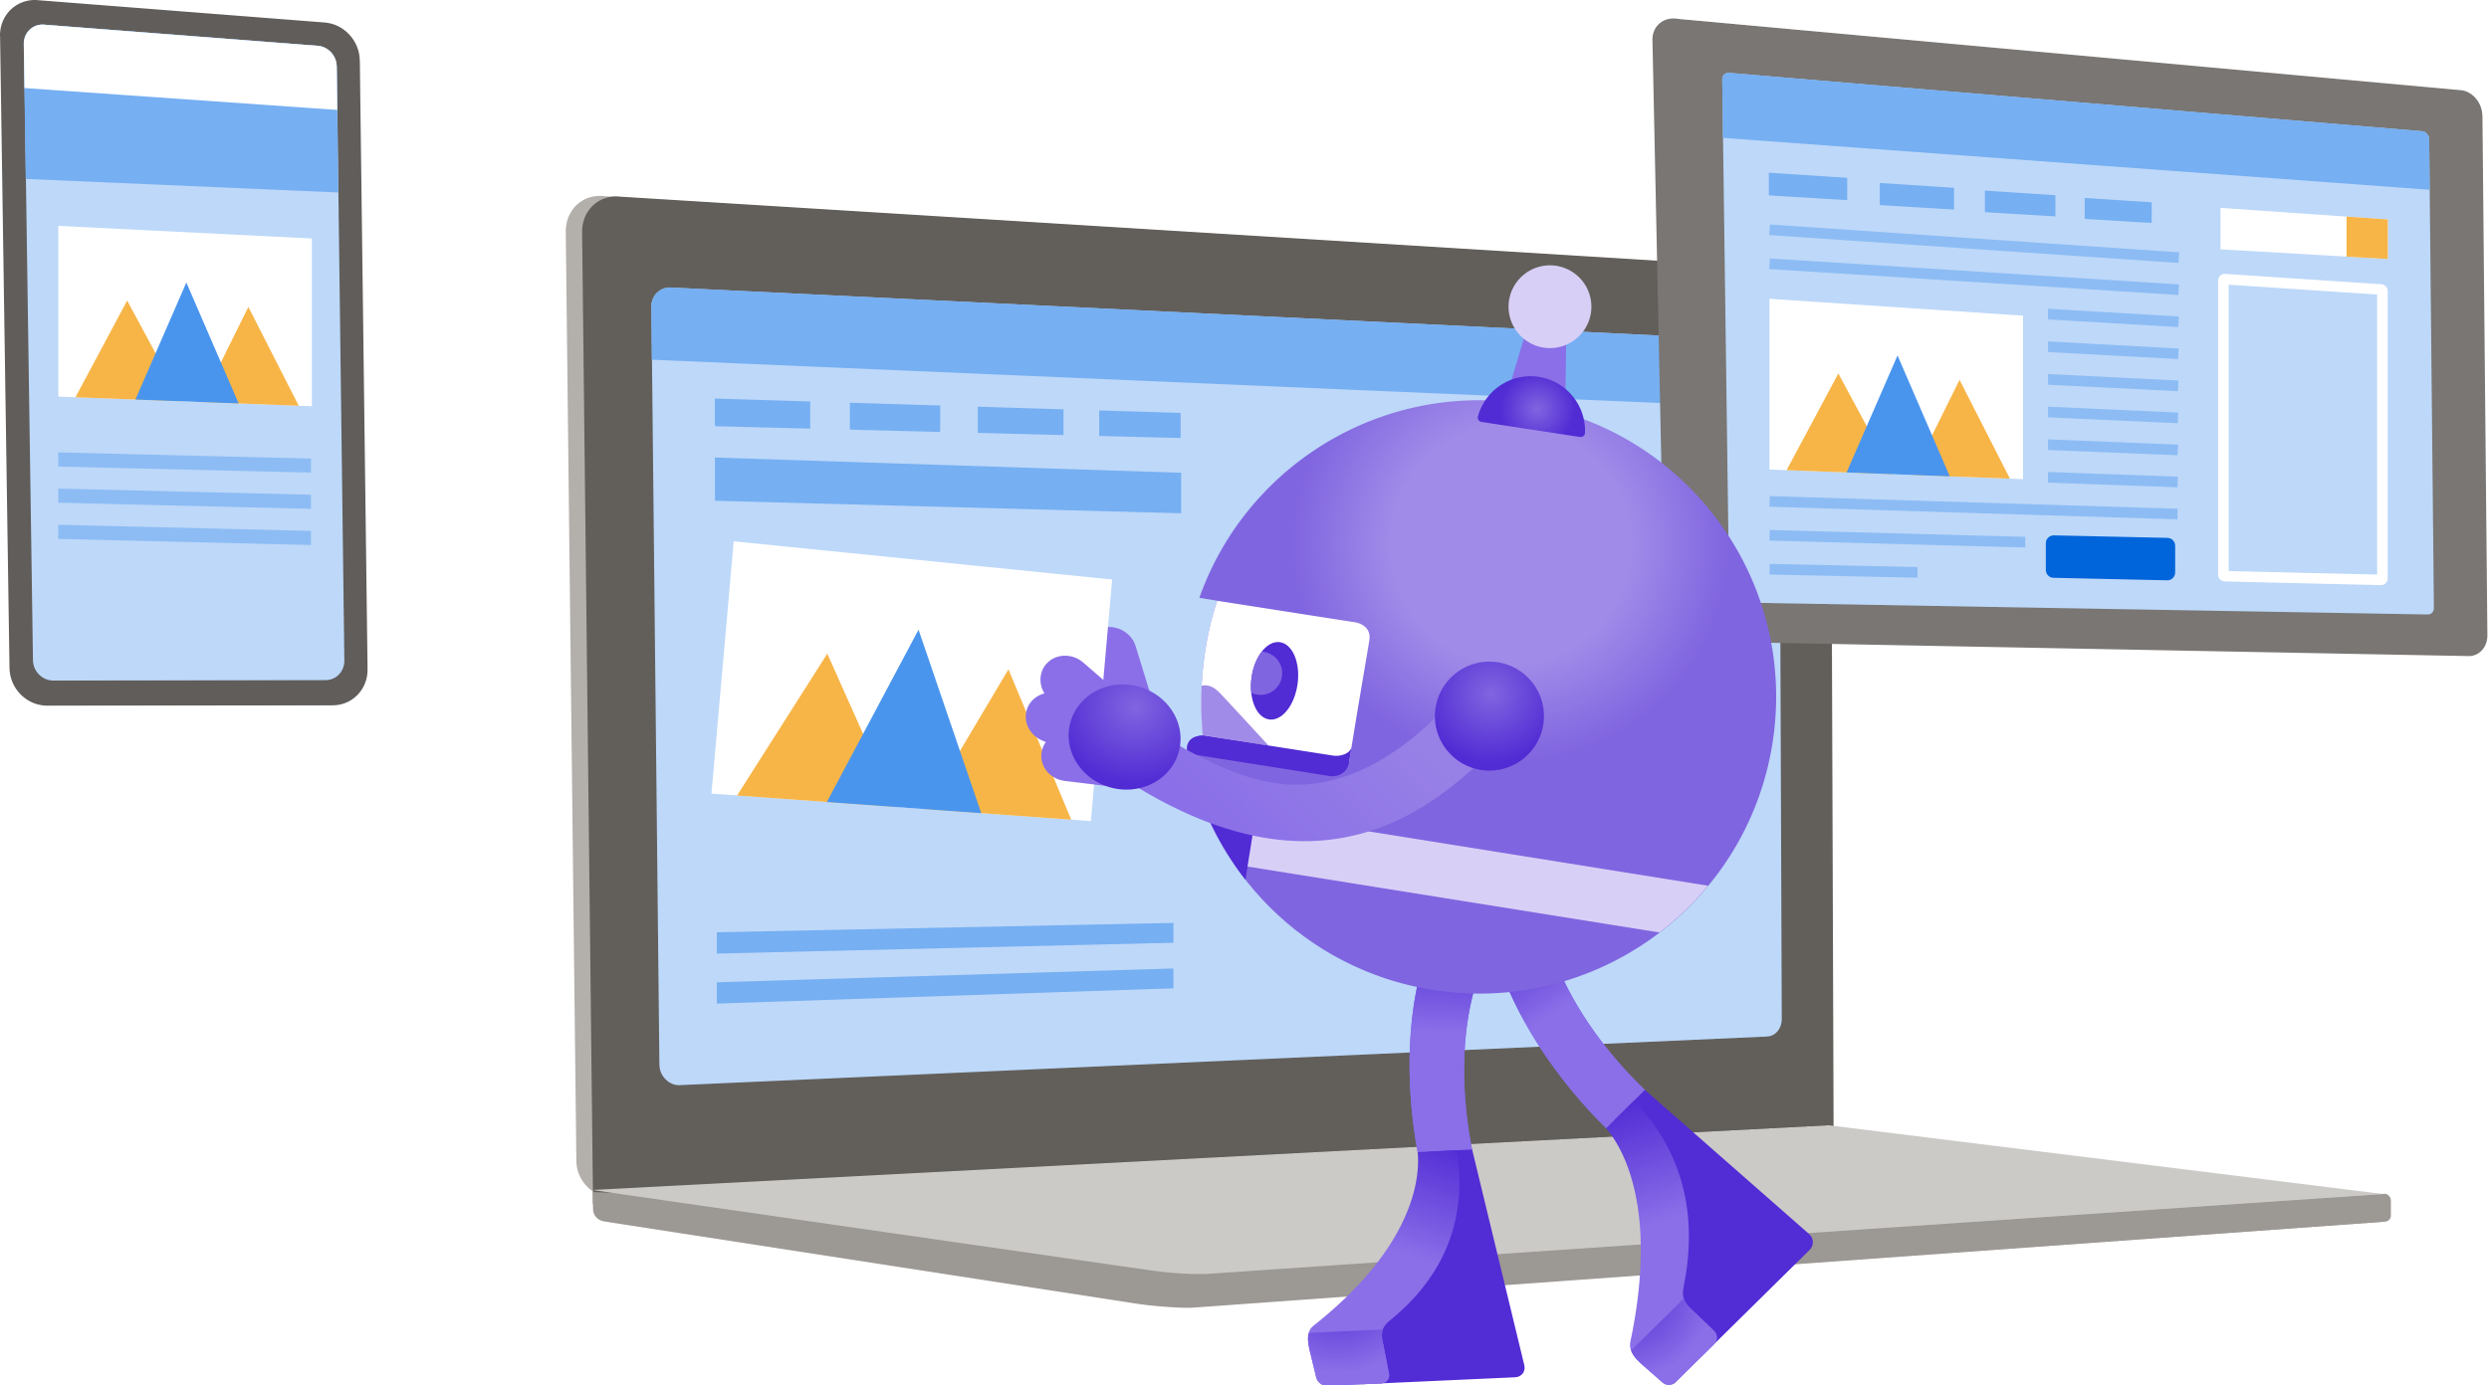
.NET Conf
Focus on MAUI
September 03, 2022
events.ebitlogix.com

Slide 2



Enabling UI Automation with Appium
Syed Hoque
Senior Software Engineer, Retail Insight.
@sinkingstar
https://www.linkedin.com/in/syed-hoque

Slide 3
Agenda
Background
Xamarin.Forms
.NET MAUI
Appium
Demo…
Q & A
Epilogue

Slide 4
Background
Back in 2016, we won a contract with a big field agency in UK to build a native mobile app supporting all 3 platforms to help field agents to review store sales performance.
With no experience of building mobile apps in the team, we knew this would be a challenge. We started looked at cross-platform solution as building 3 separate apps - one for each platform was never an option for us considering the project timelines and budget.
We quickly settled for Xamarin as our choice as we had lot of experience of WPF and C# in our team and glad that we made the right choice. At that time, it was challenging working with Xamarin, but we were happy with the overall result and amazed to see how much code could be shared across apps.
In 2018, we won a similar contract with Australia's largest retailer to do similar app which is being used by over 20k users on daily basis and now have become one of the most essential app for the retailer.
This time we decided to put more effort into doing the right things when building mobile apps, we used MVVM approach, shared components, wrote custom renderers where required, did automated builds and testing using VS AppCenter.

Slide 5
Xamarin.Forms
Mature
Battle tested
Shared code, view and layout across supported platforms
CI/CD – AppCenter, GitHub Action, Azure DevOps
Built in UI Testing Framework
Plenty of awesome third-party library support
Plethora of paid controls
Various customization via effects, custom renderer, drawn controls
Can utilize native libraries written in Swift/Objective-C or Java/Kotlin (via binding library)
Xamarin support will end on May 1, 2024, for all Xamarin SDKs. Android 13 and Xcode 14 SDKs (iOS and iPadOS 16, macOS 13) will be the final versions Xamarin will target.^{[1]}

Slide 6
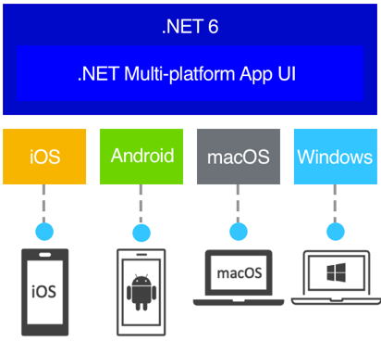
.NET MAUI
Multi-platform App UI (.NET MAUI) is a cross-platform framework for creating native mobile and desktop apps with C# and XAML.
Is the future 👀
Evolution of Xamarin.Forms
Shared code, view and layout across supported platforms
CI/CD – AppCenter, GitHub Action, Azure DevOps
Rebuilt from the ground up for performance and extensibility
.NET 6 BCL (fastest .NET yet*)
Single project structure
Hot Reload
Access to platform specific APIs
Fast adaptation from the library maintainers ^{[2]}
UI testing framework ?

Slide 7
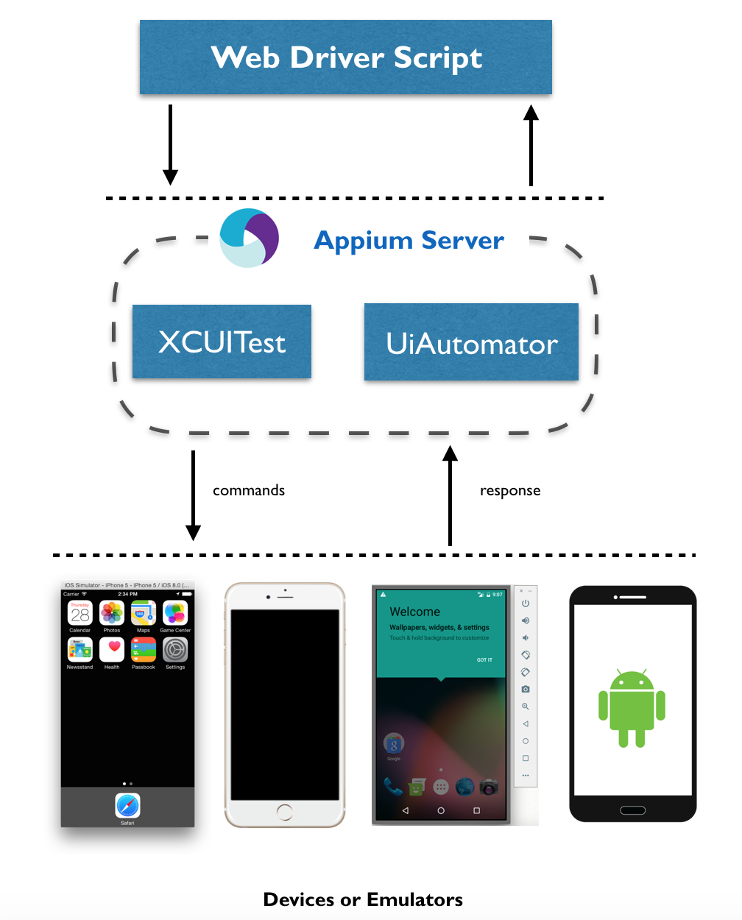
Appium
Concept:
Uses vendor-provided automation frameworks under the hood
Doesn’t add any third-party code into the application
Doesn’t require to recompile the app
This means you're testing the same app you're shipping
Java, Ruby, Python, PHP, JavaScript, and C# clients for WebDriver protocol to write tests in JUnit, NUnit etc
Both CLI and GUI client for the Appium server is available
We can utilize the CLI to integrate UI automation tests in our CI/CD pipeline.
Client/Server Architecture:
Appium is at its heart a webserver that exposes a REST API.
It receives connections from a client, listens for commands, executes those commands on a mobile device, and responds with an HTTP response representing the result of the command execution. ^{[3]}
^{[4]}

Slide 8

Demo…

Slide 9

Q & A

Slide 10
Epilogue
Thank you everyone and enjoy rest of the session
Links:
GitHub repo
Xamarin.Forms
.NET MAUI
Appium
Appium Desktop
Appium Samples

